Slide 1

How much is the Minimum wage ?

Slide 2
The Minimum wage is £6.70 per hour

Slide 3
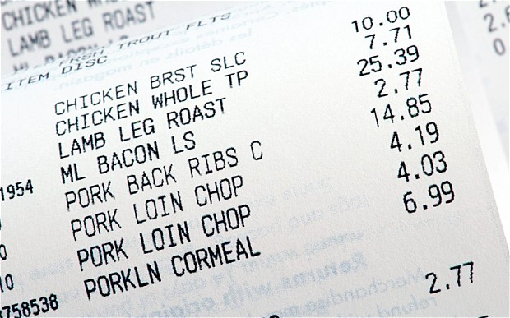
How much is the Average food bill per year ?

Slide 4
The Average food bill is £5000 per year

Slide 5

How much does the Average holiday for a family of 4 cost?

Slide 6
The Average holiday for a family of 4 cost £5,600
Notes:
5,600

Slide 7

How much does the Average car cost to run each year ?

Slide 8
The Average car cost £2000 per year to run

Slide 9

Budget time
Average Joe
Joe earns £11,000 per year.
Joe
Eats the average amount of food
Goes on the average family of 4 holiday each year
Runs a average car
Using the information previously given work out, How much money will Joe have left ?

Slide 10
Joe has -£1600 left!!!

Slide 11
What are average Joes options to get out of debt?
Loan
Gain more Income

Slide 12

What is a loan ?

Slide 13
A loan is a thing that is borrowed, especially a sum of money that is expected to be paid back with interest.
Lets watch some TV loan adverts
Notes:
00 Wonga Promo Code 2014 TV Advert Guitar Best Payday Loans Promotion Code
10 Payday Loans UK Kwik Cash Advert 2014
20 PaydayUK Command Centre TV Advert
30 QuickQuid TV 2015 Advert

Slide 14
What keywords did you notice
APR
means Annual Percentage Rate. This is the amount of how interest added to a loan or credit card each year.
Representative APR
is stated when the APR can vary. It is representative of what at least 2/3s of past customers have paid.
Terms and Conditions
are the small print that you need to look up and read carefully so that you know exactly what is going on.

Slide 15
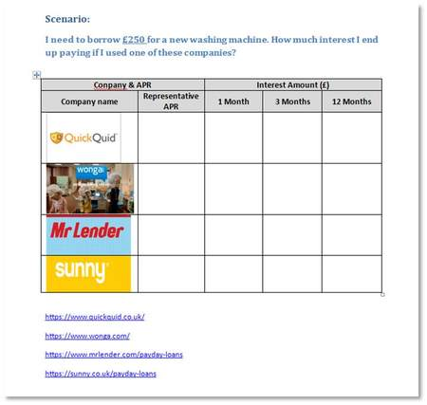
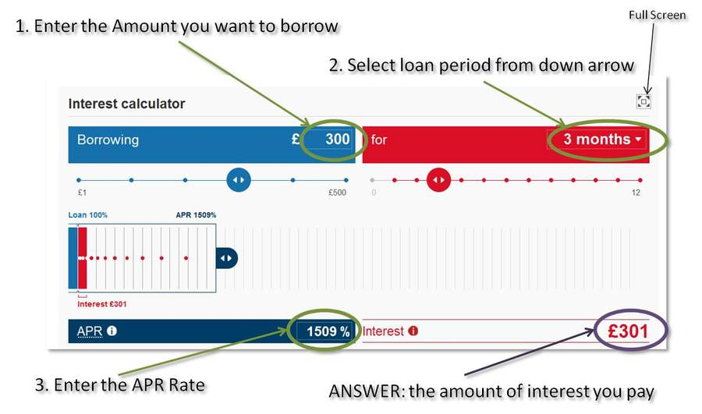
Pay Day Loan Calculations
Using the website download and open document task01.docx
Find the loan REPRESENTATIVE APR’s
Using the provided loan calculator website work out the interest for each company

Slide 16
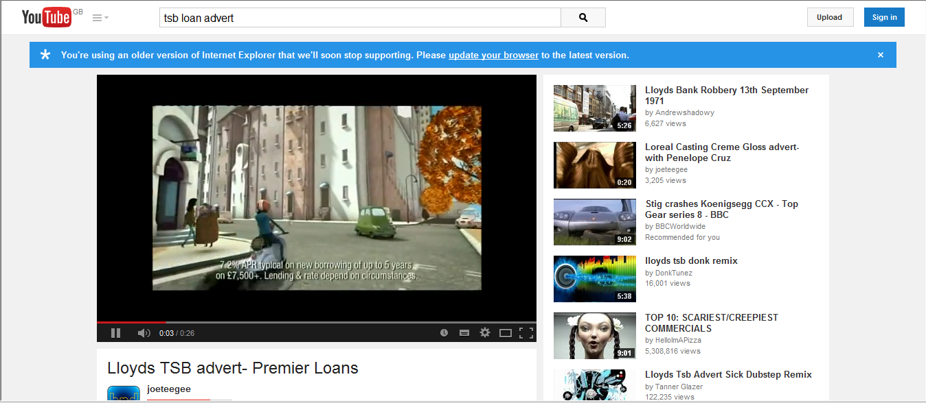
Watch this clip – what do you notice about the APR?
https://www.youtube.com/watch?v=CrbYy1KA0RQ
Notes:
50 Lloyds TSB advert Premier Loans

Slide 17
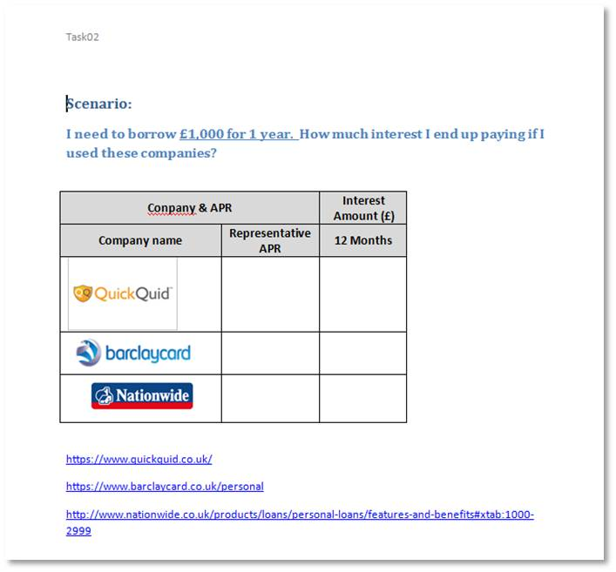
Assorted Loan Calculations
Using the website download and open document task02.docx
Find the loan REPRESENTATIVE APR’s
Using the provided loan calculator website work out the interest for each company

Slide 18
How you are judged for a Loan ?
Create a word document “loancriteria”
Using website
https://www.gobankingrates.com/personal-finance/banks-decide-personal-loan-eligibility/
Plus any other websites you can find
List the things lenders look for when making a loan decision in this word document
try to find at least 6 things
TASK 3 on the website

Slide 19
Lending Criteria
Credit score
Current income & employment
Employment history
Repayment history
Your outgoings

